Slide 1
A web scraping methodology to analyze google play apps
48th World Continuous Auditing and Reporting Symposium
David Perea
Cinta Pérez
María Asunción Grávalos
Roció Hernández
25 September 2020
Madrid, Spain

Slide 2
Agenda
Mobile apps
Applications stores
Web Page: HTML and CSS
Open Source Programming Language: R
Web scraping´s basic flow
A case study. Reviews

Slide 3
Mobile apps
The importance of mobile phones in our everyday life and activities is undeniably unending. This is so because there is ongoing tremendous transformation in that mobile phones are no longer the ordinary communication device it used to be. It has become the colossal point of attention for individuals and businesses alike, courtesy of the various incredible features and opportunities that mobile phones offer.
The cumulative progress of mobile technology, the availability and access to high speed internet and the remarkable communicative interface in these devices results into a whole level of new and innovative experience mobile computing. This is made possible through the development of mobile applications (mobile apps).
Oza H. (2017)- «The Importance Of Mobile Applications In Everyday Life!». Hyperlink Infosystem

Slide 4
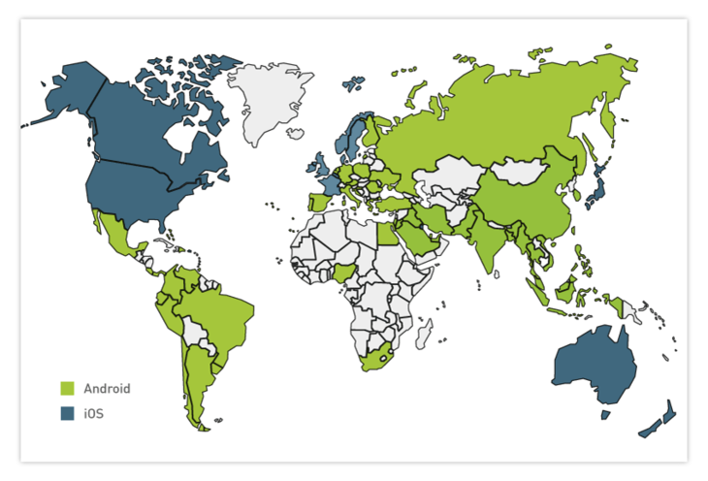
Applications stores
Applications stores (e.g. Apple App Store, Google Play) have become the dominant platforms for the distribution of software for mobile phones.
Google (Android) leads in app downloads,
Apple (IOS) has better earnings.
Möller A. et al. (2012)- «Update Behavior in App Markets and Security Implications: A Case Study in Google Play». Digitala Vetenskapliga Arkivet
This map shows that a lot of European, South American, Asian, and African countries prefer Android. Certain countries with higher incomes, including the US, some European countries, and Australia prefer iOS. These regional preferences can partially be explained by the low cost of some Android mobile phones.
Daria R. (2018)- «iOS vs Android Development: Which One is Best for Your App?». RubyGarage
iOS and Android popularity
around the world

Slide 5
Web Page: HTML and CSS
HyperText Markup Language (HTML), refers to the markup language for creating web pages. It is the most basic building block of the Web. It defines the meaning and structure of web content, such as text, images, videos , games, among others.
Other technologies besides HTML are generally used to describe a web page's appearance/presentation (CSS) or functionality/behavior (JavaScript).
Mozilla Developer Network (2019). «HTML: Hypertext Markup Language».
Cascading Style Sheets (CSS) is a style sheet language used for describing the presentation of a document written in a markup language like HTML.
Mozilla Developer Network (2019)- «CSS developer guide».

Slide 6
Open Source Programming Language: R
R is a programming language and free software environment for statistical computing and graphics supported by the R Foundation for Statistical Computing and and it is developed by academics and scientist. A core set of packages is included with the installation of R, with more than 13,500 additional packages available at the Comprehensive R Archive Network (CRAN).
Hornik, K. (2018). «"R FAQ". The Comprehensive R».
CRAN (2018). «Contributed Packages».
R Packages
rvest: helps you scrape information from web pages. It is designed to work with magrittr package to make it easy to express common web scraping tasks. It makes easy to download, then manipulate, HTML and XML.
RDocumentation (2019). «rvest v0.3.5».

Slide 7
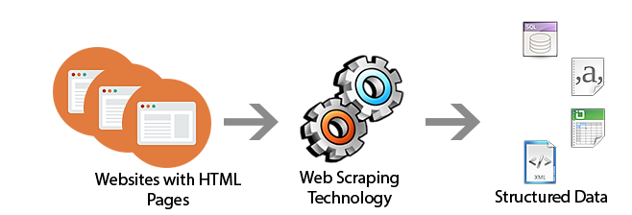
Web scraping´s basic flow
Web page structure analysis
Parse HTML content
Get the URL
Get page source
Select data
Process the data
(Back to 2 if there are more URLs)
1. 2. 3.
4. 5.
6.

Slide 8
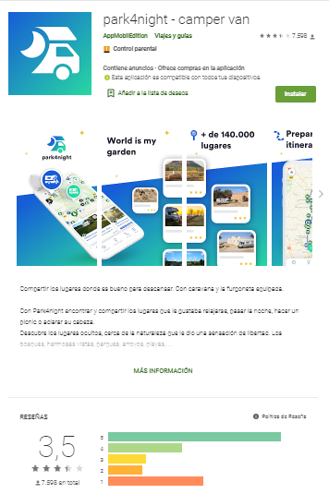
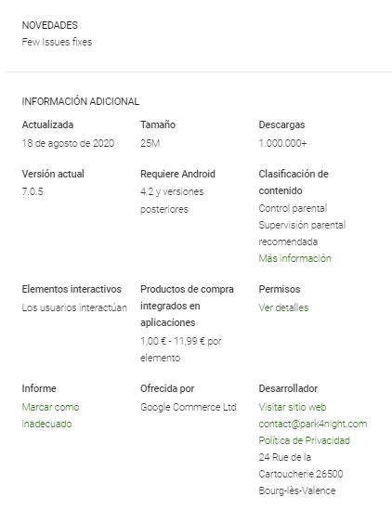
1. Search the information on the Web
App name
Developer
App category
Number stars
Number reviews
Date updated
App size
Number download
Age ratings
Description
News

Slide 9
2. Parse HTML content
Web scraping tool: SelectorGadget
SelectorGadget is an open source Chrome Extension that makes CSS selector generation and discovery on complicated sites a breeze.
It allows you to interactively figure out what CSS selector you need to extract desired components from a page.

Slide 10
2. Parse HTML content
CSS nodes
.AHFaub
App name
.R8zArc
[1] Developer
[2] App category
.BHMmbe
Number starts
.EymY4b span
Number reviews
.htlgb .IQ1z0d
[1] Date updated [2] App size
[3] Number download [6] Age ratings
.DWPxHb
[1] Description
[2] News

Slide 11
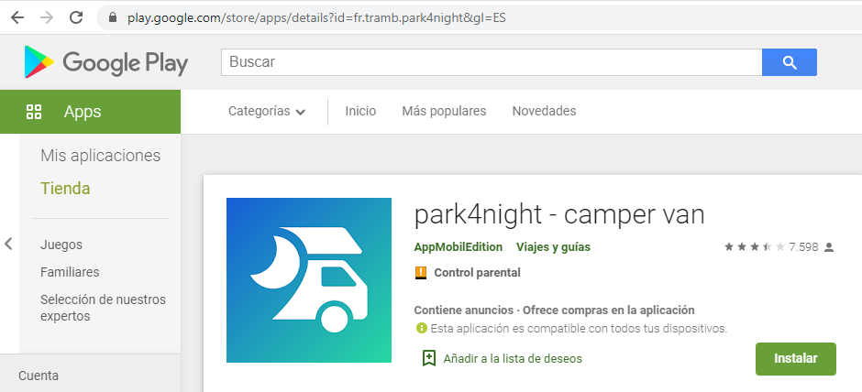
3. Get the URL
Code:

Slide 12
4. Get page source
Code:

Slide 13
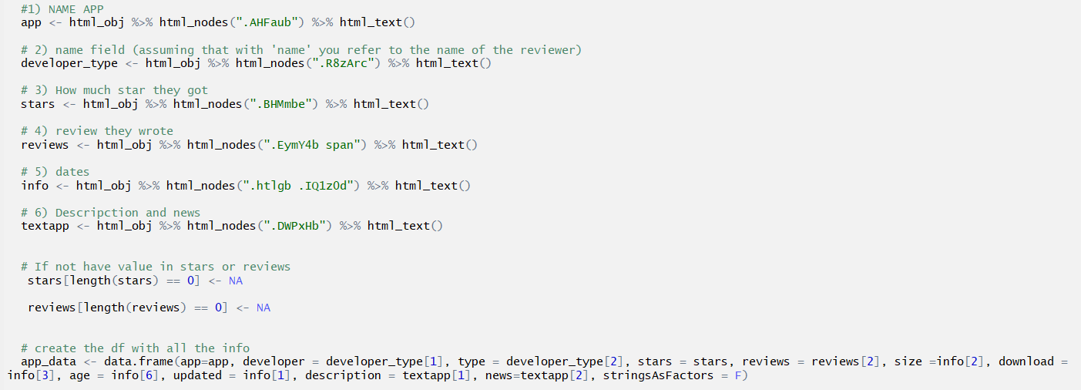
5. Select data
Code:

Slide 14
Flowchart of scraping of Google Play
rvest Package
URL
Read html
Get the content
Dataframe
read_html(url)
html_obj %>% html_nodes(“nodes”) %>% html_text()
Css nodes
name --- . AHFaub
General --- .R8zArc
[1] developer [2] app type
start --- .BHMmbe
review --- .EymY4b span
Info --- .htlgb .IQ1z0d
[1] updated [2] size [3] download [6] age
Textapp --- .DWPxHb
[1] descripction [2] news

Slide 15
6. Process the data

Slide 16
A case study. Reviews
We can implement this methodology to be able to obtain data from the reviews of the users of the apps in a massive way.
This study aims to analyze the behavior of users through their reviews on the main apps related to the caravanning sector.
940 reviews were automatically obtained from Google Play using web scraping techniques. From each of the reviews, its content, its number of likes, its assessment and whether they have received a response from the app have been analyzed.
The data has been processed using open source software, R.

Slide 17
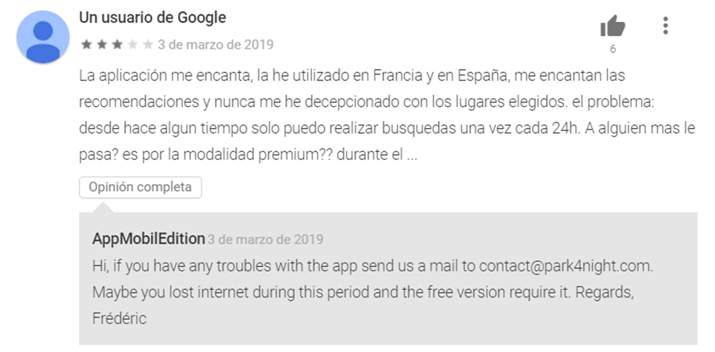
A case study. Reviews
App name: .AHFaub
User name: .kx8XBd .X43Kjb
Number starts: .kx8XBd .nt2C1d [role='img']
Dates: .bAhLNe .kx8XBd .p2TkOb
Likes: .jUL89d
Text reviews .UD7Dzf
Reply: .d15Mdf
CSS nodes

Slide 18
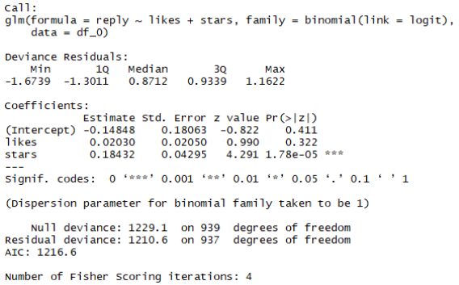
A case study. Reviews
Results
Table 2. binomial regression of resply with likes and stars
Table 1. Correlation between likes and starts

Slide 19
A case study. Reviews
Results
There is a significant negative relationship between likes and stars. Therefore, the most negative reviews (with the lowest star rating) have the highest number of likes from other users.
While a review has more or less likes, it does not depend on the response from the app developers, it does depend on the number of ratings (stars). Therefore, caravanning apps respond more to positive reviews (with more stars).
Poor support from the app's developers, since they do not answer the negative reviews that are the most supported by users.
For this methodology it is necessary to invest time in its design, but once designed it is very useful and it saves effort and time in obtaining data in a massive way.
Conclusions

Slide 20
A web scraping methodology to analyze google play apps
48th World Continuous Auditing and Reporting Symposium
David Perea pereadavid94@gmail.com
Cinta Pérez cintaperez9@gmail.com
María Asunción Grávalos
Roció Hernández
25 September 2020
Madrid, Spain

